Slide 1

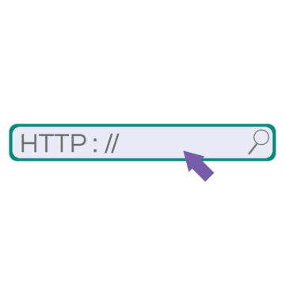
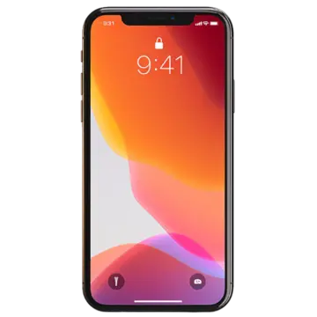











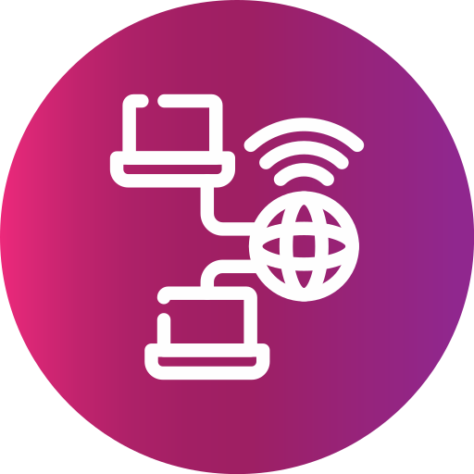

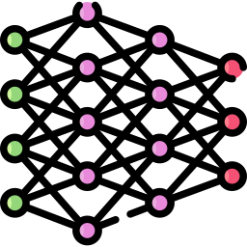











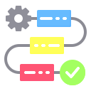
IOT STUDIO
Tech Stack and Services
End User
Main Server
Slave Servers
Private Network
SERVICES
IoTConnect
SecureStore
SmartML
Warehouse
MarketHub
CleanStream
DataView
DeepInsights
DeviceConfig
AlertCenter
Subscription
SelfCompute
CloudForge
ServiceMonitor
ServiceFlow

